Slide 1

Prediction of Dow jones stock market using time series analysis in python
Team Members
Vijay Kumar, Maniteja ladi, Guru Bhargva Reddy, Deepak Rajput

Slide 2


INFO B 512 Intro to Informatics
Prediction of Dow jones stock market using time series analysis in python
Team Members:
Vijay Kumar
Maniteja ladi
Guru Bhargva Reddy Deepak Rajput

Slide 3
Background
"If you don't think about the future, you cannot have one." ~ John Galsworthy (Nobel Prize in Literature‎)
Significance of forecasting in all fields
Budgeting, Capex & Opex allocation, surveys, Policy & decision making
Complexity of forecasting
Time series approach
Stock market prediction

Slide 4
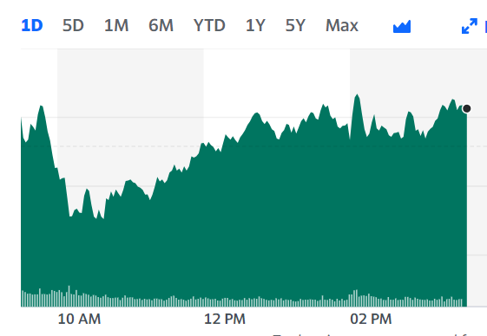
Types of stock market: 1) Price-weighted index – Dow Jones 2) Market-cap weighted index - NASDAQ

Slide 5
Type of Forecasting
Qualitative Forecasting
Quantitative Forecasting

Slide 6
Time series
A set of data depending on time
A series of values over a period of time
Collection of magnitudes belonging to different time periods of some variable or composite of variables such as production of steel, per capita income, gross national income, price of tobacco, index of industrial production.
Time is set as a device to set of common stable reference point.
In time series, time act as an independent variable to estimate dependent variables

Slide 7
Mathematical representation of Time Series
A time series is set of observation taken at specified times, usually at ‘equal intervals’
Mathematically a time series is defined by the values Y1, Y2, …. of a variable Y at times t1, t2….. Thus,
Y = F(t)

Slide 8
Component of time series
“Trend component (T)”
“Cyclic component (C)”
“Seasonal component (S)”
“Irregular component (I)”
Time séries ‘‘Y(t)= ''T(t) + C(t) + S (t) + I(t) ''
‘‘Y(t)=T(t) x C(t) x S(t) x I(t)

Slide 9

Statistical and mathematical methods to analyze the historical stock market data
Moving Averages
Relative Strength Index (RSI)
Bollinger Bands
Autoregressive Integrated Moving Average (ARIMA) models
GARCH models
Time series clustering
Overall, stock market time series analysis can provide valuable insights into market trends and help investors make more informed investment decisions.

Slide 10
Methods:
Project problem identification
Data collection and cleaning
Data analysing and model selection
Evaluation of outcomes and model performance

Slide 11
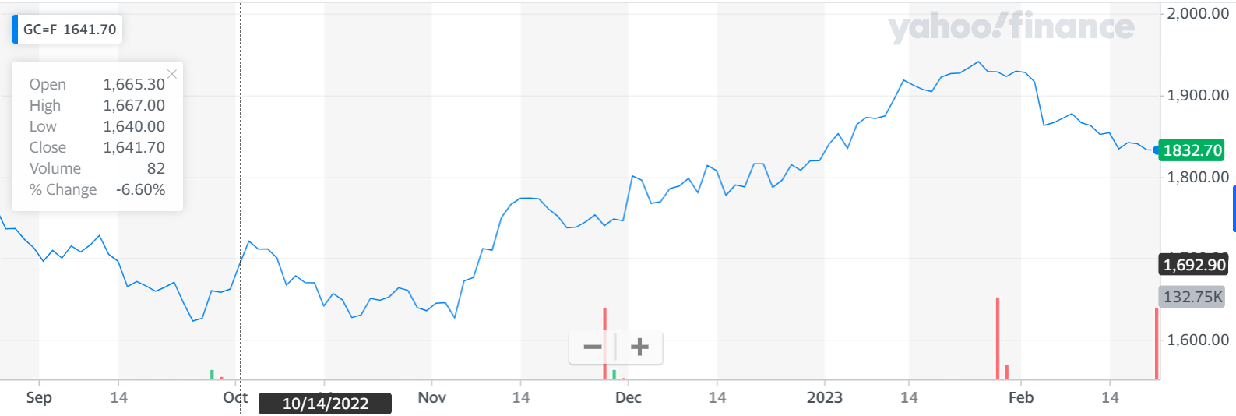
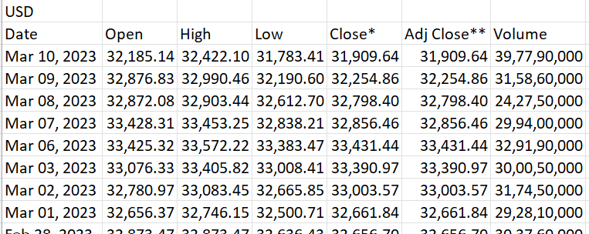
Dataset for our project
Manual & Web Scrapping via API required to get historical and current data of
Dow Jones stock exchange data from Yahoo Finance website
Link: Dow Jones Industrial Average (^DJI) Historical Data - Yahoo Finance
Downloaded dataset:

Slide 12
Simple Linear regression
Used to find a relationship between two or more variables of interest
Make predictions once these relationships established
Dependent and independent variable

Slide 13
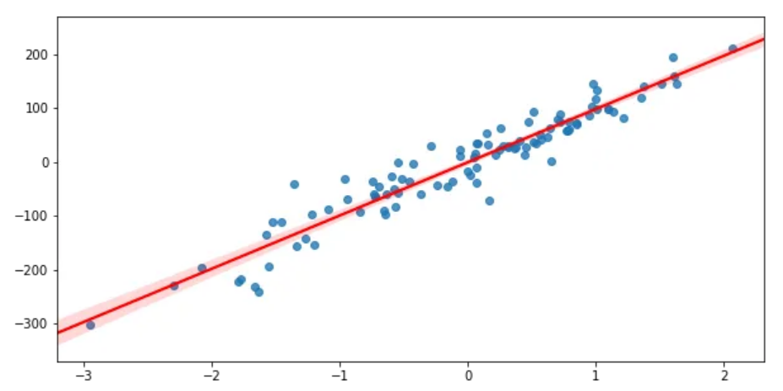

Mathematical representation of Simple linear regression
line of best fit
$y_{i}=α+βx_{i}+ε_{i}$
y — The independent variable
⍺ — The constant/y-intercept
β — The beta coefficient (slope)
ε — The error term/residuals

Slide 14
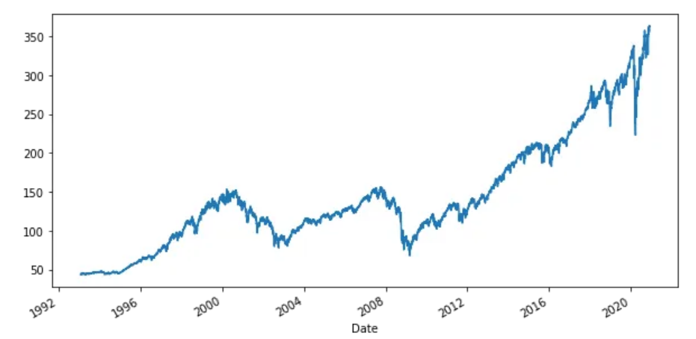
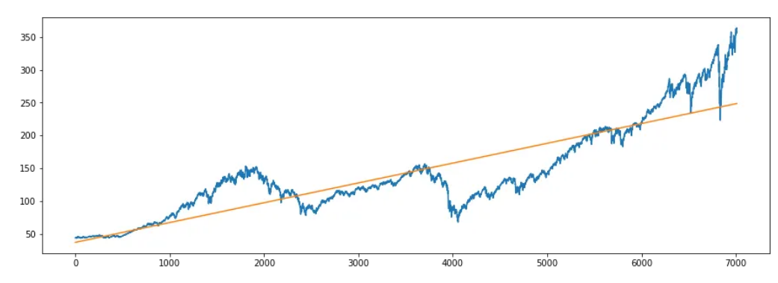
Stock Prediction using linear regression

Slide 15
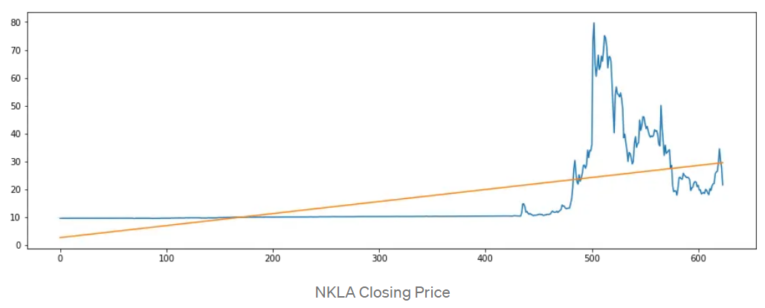
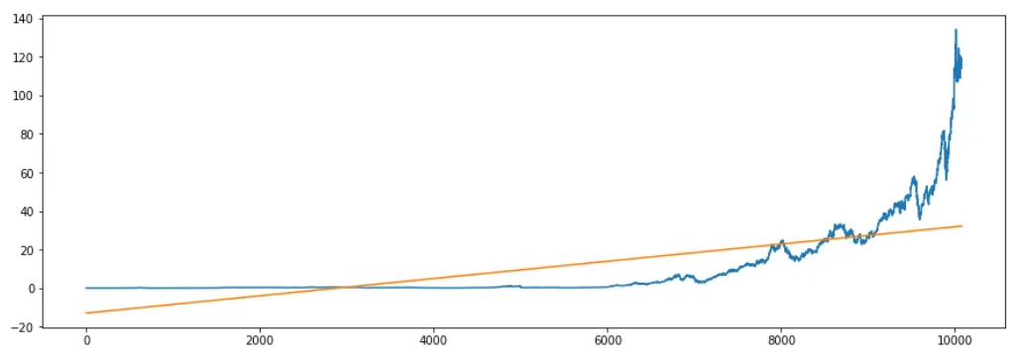
Limitation of linear regression

Slide 16
Potential benefits of the proposed project
Understanding the trends and patterns in the stock market over time.
Developing a deeper understanding of the methods and techniques used in time series analysis.
Gaining practical experience in working with financial data.
4. Exploring the challenges and limitations of using time series analysis for predicting financial markets.
5. Moreover, by building on existing work and improving upon it, you can contribute to the ongoing research and development in the field of finance and data science.

Slide 17
References:
L. Q. Yu and F. S. Rong, "Stock Market Forecasting Research Based on Neural Network and Pattern Matching," 2010 International Conference on E-Business and E-Government, Guangzhou, China, 2010, pp. 1940-1943, doi: 10.1109/ICEE.2010.490.
N. I. Sapankevych and R. Sankar, "Time Series Prediction Using Support Vector Machines: A Survey," in IEEE Computational Intelligence Magazine, vol. 4, no. 2, pp. 24-38, May 2009, doi: 10.1109/MCI.2009.932254.
Zakamulin, V. The real-life performance of market timing with moving average and time-series momentum rules. J Asset Manag 15, 261–278 (2014). https://doi.org/10.1057/jam.2014.25
S. M. Idrees, M. A. Alam and P. Agarwal, "A Prediction Approach for Stock Market Volatility Based on Time Series Data," in IEEE Access, vol. 7, pp. 17287-17298, 2019, doi: 10.1109/ACCESS.2019.2895252.
Majumder, Anup & Rahman, Md & Biswas, Al Amin & Zulfiker, Md & Basak, Sarnali. (2022). Stock Market Prediction: A Time Series Analysis. 10.1007/978-981-16-2877-1_35.

